Slide 1
PYTHON
-- OPEN SOURCE PROGRAMMING LANGUAGE ;

Slide 2
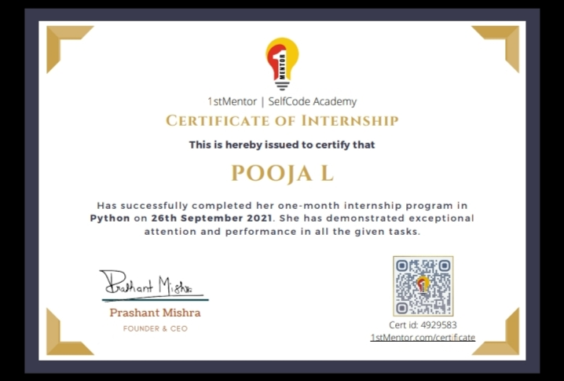
CERTIFICATE ISSUED

Slide 3
What is python?
It is created by GUIDO VAN ROSSUM in 1990.
It is an interpreted high level general purpose programming language.
First appeared in February 20,1991;30 years ago.

Slide 4
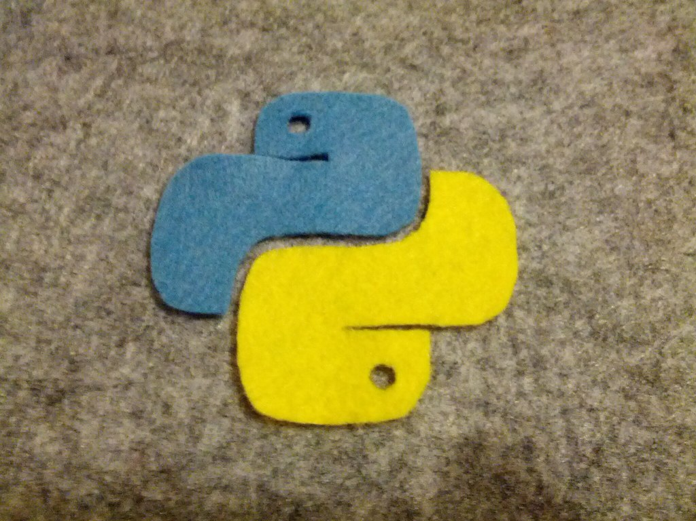
Why python?
Designed to be easy to learn ,clean and clear syntax and has very few keywords.
Highly portable, uses machine independent byte-codes.
Extensible ,designed to be extensible using C/C++, allowing access to many external libraries.
This Photo by Unknown Author is licensed under CC BY

Slide 5
Most obvious features
Clean syntax and high level data-types which leads fast coding.
Uses white space to delimit blocks.
Variables do not need declaration although not a type less language .
High level data-types ,uses white space to delimit blocks, variables do not need declaration.

Slide 6
What is python used for?
Rapid prototyping
Web scripting
Steering scientific application
Extension language
XML processing
Database applications
GUI applications
A glue language

Slide 7
Python vs java
Code 5-10 times more concise.
Widely used programming languages.
Much quicker development coz of no compilation phase and less typing.
Runs slower but the development is so much faster.
Everything is an object for java and for python the object is a feature.
Python has a smaller code compared with java.

Slide 8
Python programs
Python programs and modules are written as text files with traditionally a .py extension.
Each python module has its own discrete namespace.

Slide 9
Syntax in python
Python is a case-sensitive ,(i.e.)name and name have different meanings.
All variable should start with a lowercase letter; var = 4.
Functions begins with lowercase.
Classes begins with the capital letter.

Slide 10
Variables and Types
Variables need no declaration.
>>> a = 1
>>>
Variable name alone is an expression, the result is printed.
Objects always have a type.
Python uses exceptions.
Variables must be created before they can be used.

Slide 11
Thank you…
Presentation by .,
POOJA L
(20L236)

